Slide 1

Look N Log
developed at
CodTech - Hyderabad
Under The Guidance Of
Internal Guide
Prof. Sweta Jethava
External Guide
CodTech Solutions
Developed By
Vishwa Thakkar (2305102120017)
Submitted To:
Department of MCA
Faculty of IT & Computer Science,
PARUL University
LOOK N LOG
1

Slide 2
Contents :
About the Project
Existing Systems and Their Limitations
Problem Statements and Need for New System
Proposed System and Features
System Architecture and Design
Implementation Plan
Testing Strategy and Test Cases
Future Enhancements
Conclusion
Demonstration
LOOK N LOG
2

Slide 3
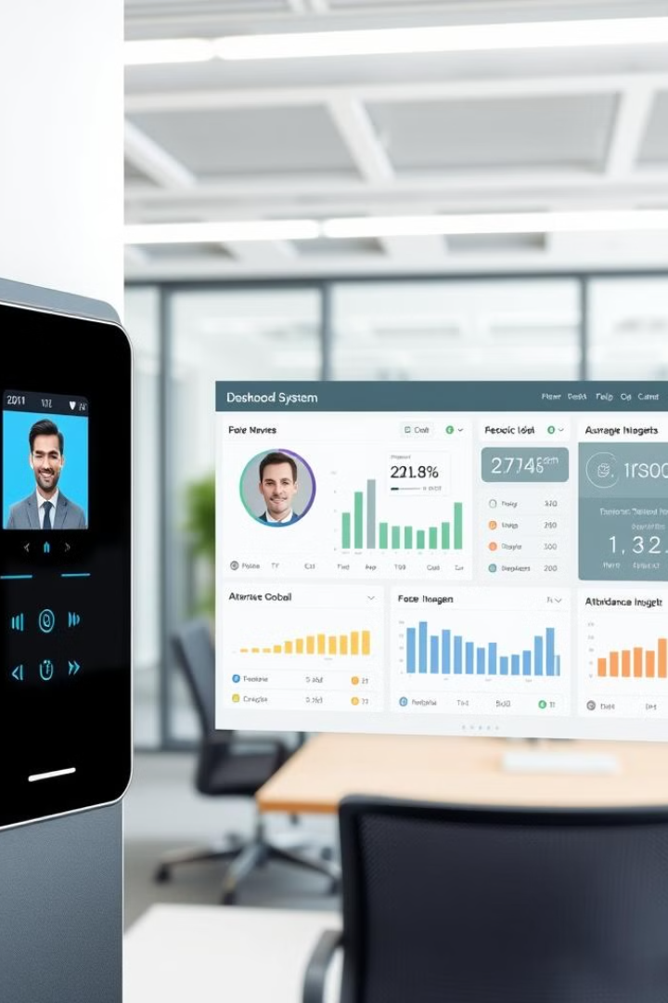
1. About the Project:
The system automates attendance tracking using facial recognition technology.
This provides a contactless and efficient alternative to traditional methods.
It captures unique facial features and matches them against a stored database for accurate identification.
The Face Detection Attendance System automates attendance tracking using facial recognition technology.
It aims to provide a contactless, efficient, and secure alternative to traditional attendance methods.
LOOK N LOG
3

Slide 4
2. Existing Systems and Their Limitations:
Inaccurate Data
Traditional attendance systems, like paper logs or card-based systems, are susceptible to human errors and fraud.
Inconvenience
Physical attendance systems require users to manually sign in or scan cards, which is time-consuming and prone to mistakes.
Security Issues
Lack of Automation
Paper and card-based systems are vulnerable to being misplaced or manipulated, leading to inaccurate attendance records.
Existing systems often require manual intervention for correction, tracking, and reporting attendance data, leading to inefficiency.
LOOK N LOG
4

Slide 5
2. Existing Systems and Their Limitations:
Biometric attendance systems face several challenges.
They may not be suitable for all users, especially those with disabilities or medical conditions.
Hygiene concerns arise due to physical contact with scanners, discouraging usage in health-sensitive environments.
High costs for installation, maintenance, and staff training can strain budgets, particularly for smaller organizations.
Privacy risks also exist, as biometric data collection raises security and ethical concerns.
Organizations must implement clear policies to protect user data and ensure smooth adoption while addressing compatibility, hygiene, cost, and privacy issues.
Traditional attendance systems, such as paper-based methods, are prone to human errors like miscalculations, illegible handwriting, and oversight, leading to inaccurate records.
They also create inefficiencies in record-keeping and retrieval, making the process time-consuming and frustrating for administrators.
Additionally, these systems lack real-time data processing, preventing organizations from addressing absenteeism effectively.
Another major concern is the environmental impact, as paper usage contributes to deforestation and waste.
Transitioning to digital solutions can improve accuracy, efficiency, and sustainability while streamlining attendance management for organizations.
LOOK N LOG
5

Slide 6
3. Problem Statements :
Current System Limitations
Attendance systems struggle to scale. This limits their effectiveness in larger organizations.
Attendance Inaccuracies
Manual processes lead to misreported attendance. This causes discrepancies in records.
Need for Automation
Manual attendance processes are time-consuming. This increases operational costs significantly.
Reporting features are often rigid. This makes data analysis challenging.
Human error is prevalent in current systems. There is a clear need for automated solutions.
Real-time updates are lacking. This complicates tracking for remote participants.
Security Vulnerabilities
Existing systems are at risk of data breaches. Unauthorized access remains a significant concern.
Weak encryption measures expose sensitive information.
This increases vulnerability to threats.
LOOK N LOG
6

Slide 7
3. Need of new System:
Real-time Recognition
Utilizes advanced facial recognition technology to capture and identify users instantly.
Centralised Database Management
Maintains a secure and organized database of user facial data and attendance records.
Comprehensive Reporting Tools
Generates detailed attendance reports for analysis and review.
Automated Attendance Logging
Automatically logs attendance upon successful facial recognition.
Ensures accurate attendance marking with minimal delay.
Reduces manual intervention and errors in attendance tracking.
Facilitates easy access and management of user information for administrators.
Provides insights into attendance patterns and user behavior.
User Notification System
Sends real-time notifications to users regarding their attendance status.
Informs users of any discrepancies or issues with attendance logging.
LOOK N LOG
7

Slide 8
4. Proposed System and Features:
ATTENDANCE MARKING
The system will mark attendance for educational institutions, workplaces, or other organizations.
INTEGRATION
The system can be integrated with existing management software to sync attendance data.
MULTI-USER SUPPORT
The system can manage attendance for a large number of users.
DATA ANALYTICS AND REPORTING
Provides attendance reports based on daily, weekly, or monthly data.
USER NOTIFICATION SYSTEM
Sends real-time notifications to users regarding their attendance status.
LOOK N LOG
8

Slide 9
5. System Architecture and Design:
FACE ENROLLMENT
Allows users to register their facial data by capturing their face image.
FACE RECOGNITION
Identifies and authenticates users using facial features to match the user's image with the one stored in the database.
ATTENDANCE MANAGEMENT
Records and manages attendance by associating recognized faces with specific times and dates.
DATABASE MANAGEMENT
Manages user data, including images, attendance logs, and metadata related to facial recognition results.
LOOK N LOG
9

Slide 10
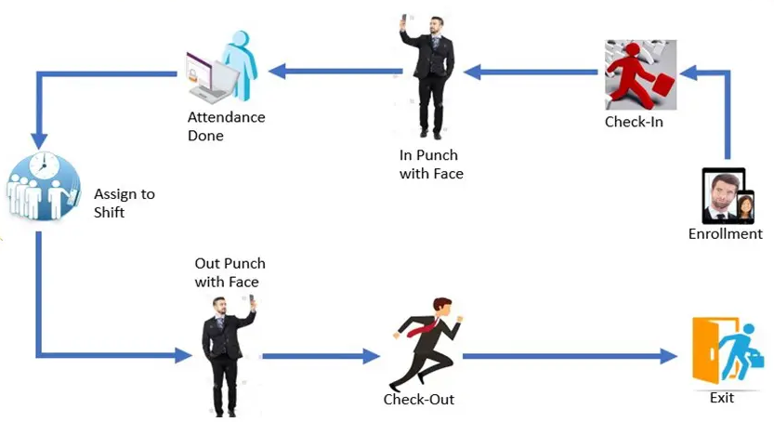
5. System Architecture and Design:
Sends an email
LOOK N LOG
10

Slide 11
6. Implementation Plan:
Planning Phase
Conduct requirement analysis and feasibility study to define project scope and objectives.
Design
Development
Develop system architecture and design user interfaces.
Algorithm
Implementation
Implement facial recognition algorithms and integrate them with the attendance management system.
Testing Procedures
Conduct unit, integration, and user acceptance testing to ensure system functionality and reliability.
Deployment & Support
Deploy the system in a real-world environment and provide training for users and administrators.
LOOK N LOG
11

Slide 12
7. Testing Strategy and Test Cases:
UNIT TESTING
Focuses on individual components or modules to ensure they function correctly.
INTEGRATION TESTING
Tests the interaction between integrated components to identify interface defects.
SYSTEM TESTING
Evaluates the complete and integrated software to ensure it meets specified requirements.
Specific test cases include verifying successful registration with valid data and error handling for invalid data.
Key test cases involve checking the integration of user registration with the attendance logging system.
Includes testing the overall functionality of the attendance system, such as check-in and check-out processes.
USER ACCEPTANCE TESTING
Conducted to validate the system's functionality from the end-user perspective.
Test cases include verifying user satisfaction with the attendance marking process and report generation.
LOOK N LOG
12

Slide 13
8. Future Enhancements:
Behavioural Analysis
Predictive Forecasting
Emotion Detection
Monitor gait and posture to identify attendance issues.
Use machine learning to analyze behavior patterns.
Context-Aware Attendance
Adjust attendance recording based on environmental factors like noise and occupancy.
Improve accuracy by adapting to real-time conditions.
Biometric Fusion
Integrate facial recognition with voice or iris recognition for added security.
Enhance authentication through multiple biometric methods.
Utilize machine learning to predict attendance trends.
Support better resource management and scheduling.
Assess user emotions during check-in/out to gauge satisfaction.
Provide insights into overall workplace engagement.
LOOK N LOG
13

Slide 14
9. Conclusion:
Automated Attendance
The Face Recognition Attendance System streamlines the attendance process by automatically logging attendance upon successful facial recognition. This reduces the time and effort required for manual attendance tracking.
Enhanced Security
Utilizing advanced facial recognition technology, the system significantly improves security by preventing unauthorized attendance and fraud. It ensures that only registered individuals can mark their presence.
Real-time Processing
The system processes facial recognition in real-time, allowing for immediate attendance marking and feedback to users. This enhances operational efficiency and user experience.
LOOK N LOG
14

Slide 15
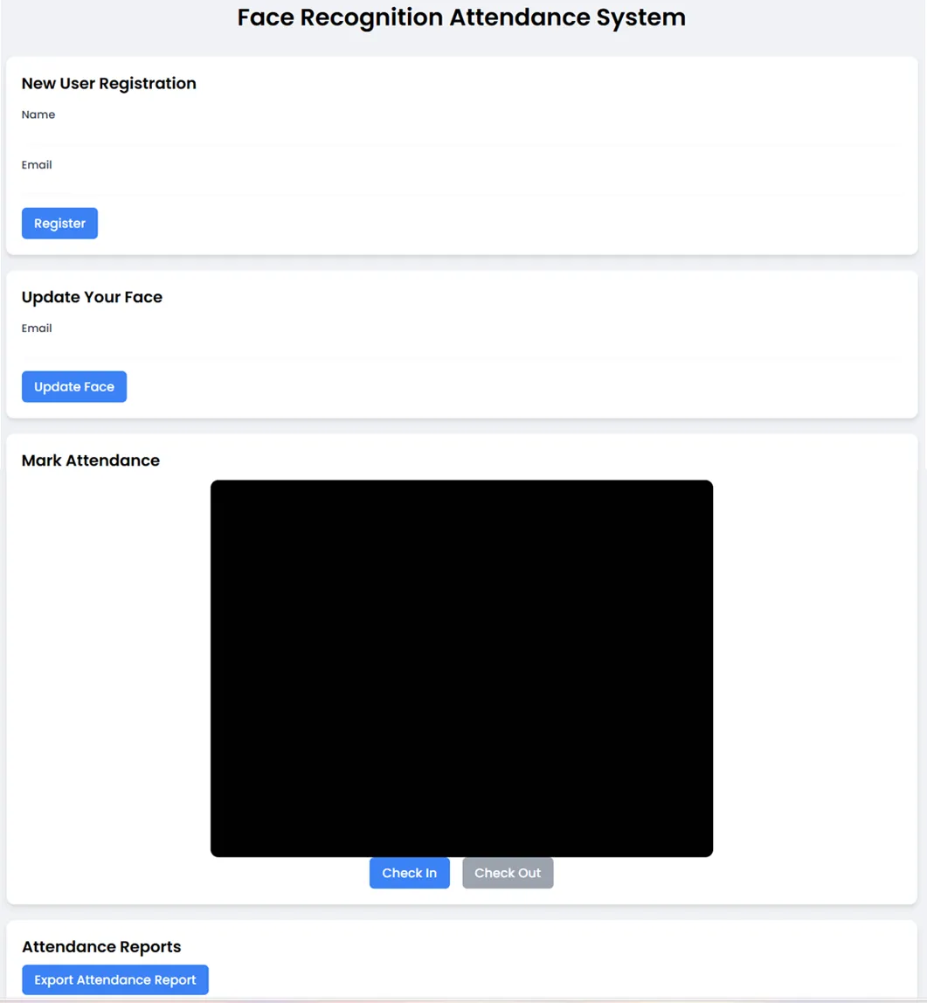
USER REGISTRATION SECTION
10. Demo:
FACE REGISTRATION SECTION
ATTENDANCE MARKING SECTION
EXPORT ATTENDANCE TO EXCEL
LOOK N LOG
15

